Slide 1
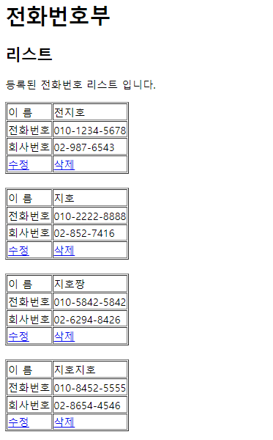
PhoneBook3 분석
01
분석-삭제
http://localhost:8088/PhoneBook3/PBC?
action=delete&id=3
Request(요청)
Tomcat
PhoneBook3
Request header
Request body
(파라미터)
: action, id
Controller(servlet)
객체
PersonDao 객체
request
delete일때
personDelete(3)
response
Response(응답)
Response header
Response body
(리다이렉트코드) : list
DB
http://localhost:8088/PhoneBook3/PBC?action=list

Slide 2
PhoneBook3 분석
01
분석-수정폼
http://localhost:8088/PhoneBook3/PBC?
action=updateForm&id=3
Request(요청)
Tomcat
PhoneBook3
Request header
Request body
(파라미터)
: action, id
Controller(servlet)
객체
PersonDao 객체
request
update
Form일때
personSelect
One(3)
response
포워드
request
Response(응답)
updateForm.jsp
객체
Response header
Response body
(html)
response
DB
http://localhost:8088/PhoneBook3/PBC?action=list

Slide 3
PhoneBook3 분석
01
분석-수정
action=update&name=지호&hp=010-2222-2222&company=02-222-2222
http://localhost:8088/PhoneBook3/PBC?
Request(요청)
Tomcat
Request header
Request body
(파라미터)
: action, name, hp, company
PhoneBook3
Controller(servlet)
객체
PersonDao 객체
request
update일때
person
Update(vo)
response
Response(응답)
Response header
Response body
(리다이렉트코드) : list
DB
http://localhost:8088/PhoneBook3/PBC?action=list

